Slide 1
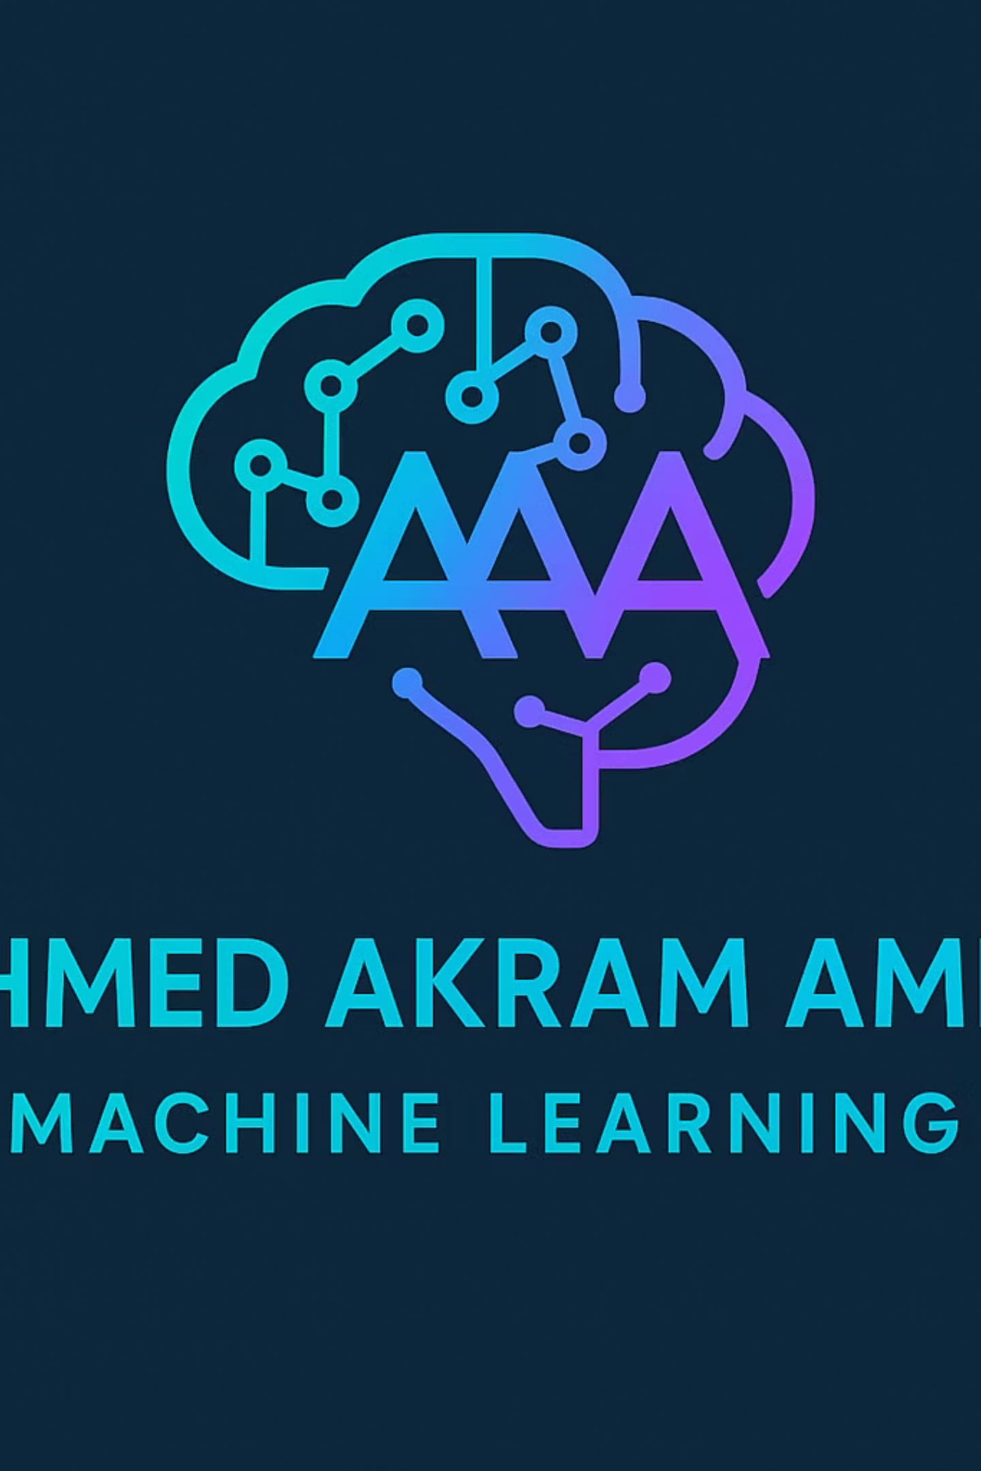
Machine Learning: Decoding the Revolution
Embark on a journey to understand Machine Learning, the driving force behind many of today's technological advancements. From self-driving cars to personalized recommendations, ML is reshaping our world. This presentation will demystify its core concepts, explore its various types, delve into essential algorithms, and highlight its profound real-world impact.

Slide 2
Unpacking Machine Learning: An Introduction & Agenda
Welcome to our exploration of Machine Learning. This agenda outlines our journey to understanding this transformative field. We'll start with the fundamentals and progressively build our knowledge, covering the essential aspects of ML.
01
02
Defining Machine Learning
Types of Machine Learning
Understanding what ML truly is.
Supervised, Unsupervised, and Reinforcement Learning.
03
04
Key Algorithms
Essential ML Jargon
Exploring the tools behind the intelligence.
Demystifying common terms.
05
06
Real-World Applications
Key Takeaways
Seeing ML in action across industries.
Summarizing our learning journey.

Slide 3
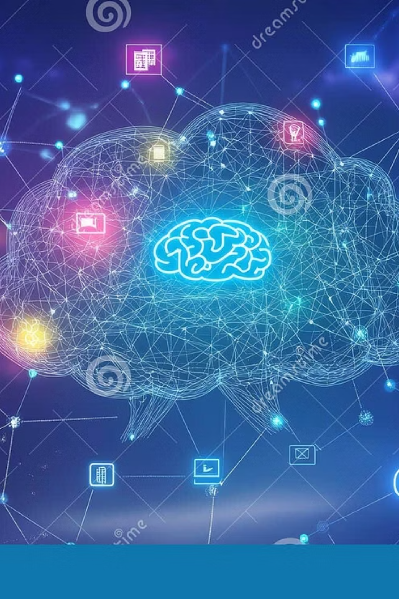
What is Machine Learning? The Core Definition
Machine Learning (ML) is a subset of Artificial Intelligence (AI) that empowers systems to learn from data, identify patterns, and make decisions with minimal human intervention. Unlike traditional programming, where rules are explicitly coded, ML algorithms are designed to adapt and improve their performance over time as they are exposed to more data. This adaptive capability is what makes ML so powerful in handling complex, real-world problems.
"Machine learning is the science of getting computers to act without being explicitly programmed." — Arthur Samuel, IBM, 1959
At its heart, ML is about enabling computers to learn from experience, much like humans do. This learning process involves training models on vast datasets, allowing them to uncover hidden relationships and predict outcomes with increasing accuracy.

Slide 4
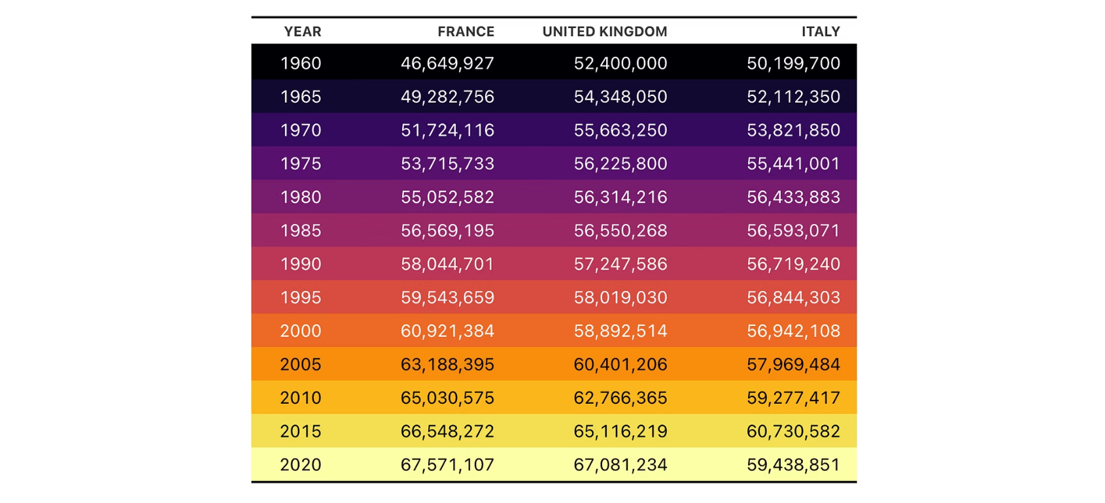

Types of ML: Supervised Learning Explained
Supervised Learning is the most common type of Machine Learning, where the algorithm learns from a labeled dataset. This means each data point comes with an associated "correct answer" or output. The model then learns to map input data to its corresponding output, similar to how a student learns from examples with a teacher's guidance.
Key Characteristics:
Labeled Data: Requires input data with known output labels.
Goal-Oriented: Aims to predict a specific outcome or categorize data.
Common Tasks: Classification (predicting categories) and Regression (predicting continuous values).
In essence, supervised learning is about teaching the machine by providing it with examples of correct behavior. This method is widely used in applications like image recognition, natural language processing, and predictive analytics.
Example: Spam Detection
A supervised learning model is trained on emails explicitly marked as "spam" or "not spam." It learns to identify patterns and features in new emails to accurately classify them.

Slide 5
Types of ML: Unsupervised Learning & Its Use Cases
Unsupervised Learning deals with unlabeled data, where the algorithm must find patterns, structures, or relationships within the data on its own. It's like allowing a student to explore a vast library without a specific lesson plan, discovering connections independently.
Clustering
Dimensionality Reduction
Association Rule Mining
Groups similar data points together based on inherent similarities. Used in customer segmentation, market analysis, and anomaly detection.
Simplifies data by reducing the number of variables while preserving important information. Useful for data visualization and improving algorithm efficiency.
Discovers interesting relationships between variables in large databases. Frequently used in retail for "market basket analysis."
K-Means Clustering
Hierarchical Clustering
Apriori Algorithm
Principal Component Analysis (PCA)
t-Distributed Stochastic Neighbor Embedding (t-SNE)
Unsupervised learning is crucial for exploratory data analysis, pattern discovery, and preparing data for further processing, making it a foundational tool in many data science applications.

Slide 6

Types of ML: Reinforcement Learning in Action
Reinforcement Learning (RL) is a paradigm where an agent learns to make decisions by interacting with an environment. It receives rewards for desired actions and penalties for undesirable ones, aiming to maximize its cumulative reward over time. This trial-and-error approach mirrors how humans and animals learn.
Key Elements:
Agent: The learning entity (e.g., a robot, a game AI).
Environment: The world the agent interacts with.
State: The current situation of the agent in the environment.
Action: What the agent chooses to do.
Reward: Feedback from the environment based on the action.
"Reinforcement learning is the closest to how humans and animals learn."
RL has shown remarkable success in complex scenarios like training AI to play games (e.g., AlphaGo), controlling autonomous vehicles, and optimizing robotic movements. It thrives in situations where explicit rules are hard to define, and learning from experience is paramount.

Slide 7






Key ML Algorithms: From Linear Models to Neural Networks
The power of Machine Learning lies in its diverse array of algorithms, each suited for different tasks and data types. Here are some of the foundational and cutting-edge algorithms:
Linear Regression
Decision Trees
A statistical method for modeling the relationship between a scalar response and one or more explanatory variables.
Tree-like models that classify or predict outcomes by breaking down data into smaller and smaller subsets based on feature values.
Neural Networks
Support Vector Machines (SVM)
Inspired by the human brain, these algorithms consist of interconnected nodes (neurons) that process and transmit information.
Powerful for classification, SVMs find the optimal hyperplane that best separates data points into different classes.
K-Means Clustering
Random Forests
An unsupervised algorithm that partitions data into 'k' clusters, where each data point belongs to the cluster with the nearest mean.
An ensemble method that builds multiple decision trees and merges their outputs to improve accuracy and reduce overfitting.
Choosing the right algorithm is critical and depends on the problem at hand, the nature of the data, and the desired outcome.

Slide 8
Essential ML Jargon: Understanding the Lexicon
Navigating the world of Machine Learning requires familiarity with its specialized terminology. Here are some critical terms you'll encounter:
Model
The output of a machine learning algorithm trained on data. It makes predictions or classifications based on new inputs. (Function Approximation)
Feature
An individual measurable property or characteristic of a phenomenon being observed. Input variables to the model.
Dataset
A collection of related sets of information that is composed of separate elements but can be manipulated as a unit by a computer.
Training Data
The portion of the dataset used to train the machine learning model. The model learns patterns from this data.
Test Data
The portion of the dataset used to evaluate the trained model's performance on unseen data, ensuring generalization.
Overfitting
When a model learns the training data too well, including its noise, leading to poor performance on new, unseen data.
Bias
The tendency of a model to consistently learn the wrong relationship between input and output, leading to systematic errors.
Accuracy
A common metric representing the proportion of correct predictions made by the model out of the total predictions.
Understanding these terms is fundamental to comprehending ML concepts and communicating effectively within the field and there are many more terms , we will learn it in the future.

Slide 9






Real-World Impact: ML Applications Across Industries
Machine Learning is no longer a theoretical concept; it's a practical tool driving innovation and efficiency across virtually every sector. Its impact is visible in countless daily interactions.
From healthcare to finance, and manufacturing to entertainment, ML is empowering organizations to make data-driven decisions, automate complex tasks, and create highly personalized experiences. Its ability to process vast amounts of data and extract actionable insights is revolutionizing how businesses operate and how individuals interact with technology.

Slide 10
Key Takeaways & Further Exploration
We've covered the fundamentals of Machine Learning, its diverse types, key algorithms, and its profound impact. Here are the core ideas to remember and paths for continued learning.
ML is about learning from data
Not explicit programming, enabling adaptive systems.
Three core types drive different goals
Supervised (labeled data), Unsupervised (unlabeled data), and Reinforcement (trial-and-error).
Algorithms are the engine
From simple linear models to complex neural networks, each has its purpose.
Jargon simplifies complex ideas
Understanding terms like 'model,' 'feature,' and 'overfitting' is crucial.
ML transforms industries
From healthcare to automotive, its applications are vast and growing.
Ready to dive deeper?
Consider exploring online courses, practical projects, and reputable academic resources to advance your understanding of this fascinating field. The journey into Machine Learning is continuous and rewarding.

Slide 11



Contacts

